Slide 1


Airport Management Systems
Prepared By:
Mohamed Hesham Abo Elkher Ezz Eldin Shiref
Ibrahim Nafea Abdallah Hamdy Braya
Hesham Hesham Elazeby Mohmaed Hesham Elzahar

Slide 2
Problem Definition::
aviation industry faces challenges in efficiently managing airport operations, including passenger flow, flight scheduling, and security measures. Manual processes often lead to inefficiencies, delays, and safety concerns. Therefore, the objective of implementing an Airport Management System (AMS) is to automate and streamline airport operations to enhance efficiency, safety, and passenger experience.

Slide 3
Project Objectives:
1. Automate Passenger Processes: Implement self-service kiosks and online check-in to reduce queuing times and improve passenger flow.
2. Optimize Flight Operations: Develop a system to efficiently manage flight schedules, gate assignments, and aircraft movements to minimize delays.
3. Enhance Security Measures: Integrate advanced security systems to screen passengers, luggage, and cargo for prohibited items and ensure regulatory compliance.
4. Improve Resource Allocation: Utilize AMS to optimize the allocation of airport resources such as gates, check-in counters, and ground handling equipment based on real-time demand.

Slide 4
5. Enhance Passenger Experience: Implement features such as flight status updates, way finding assistance, and Personalized servies to improve overall passenger satisfaction.
By addressing these objectives, the AMS aims to transform airport operations, enhance safety and security, and improve the overall passenger experience.

Slide 5
Introduction:
The aviation industry stands at the forefront of modern transportation, connecting people and goods across the globe with unprecedented speed and efficiency. At the heart of this industry lies the airport, a bustling hub of activity where countless processes must seamlessly synchronize to ensure the safe and timely arrival and departure of flights. However, the complexities of managing airport operations, coupled with ever-increasing passenger volumes and stringent security requirements, present significant challenges to airport authorities and stakeholders.
In response to these challenges, the concept of Airport Management Systems (AMS) has emerged as a transformative solution poised to revolutionize the way airports operate. An AMS represents a comprehensive software ecosystem designed to automate and optimize a myriad of processes within the airport environment, ranging from passenger check-in to baggage handling, flight scheduling, security management, and more. By leveraging cutting-edge technology and data-driven insights, AMS empowers airport authorities to enhance efficiency, improve safety standards, and elevate the overall passenger experience.
The implementation of an AMS is driven by a myriad of factors, including the need to streamline operations, reduce costs, and comply with stringent regulatory standards imposed by aviation authorities. Moreover, the ever-evolving landscape of the aviation industry, characterized by dynamic passenger demands and rapid technological advancements, underscores the imperative for airports to embrace innovative solutions that can adapt to
changing needs and deliver sustainable performance.

Slide 6
Against this backdrop, this report seeks to explore the concept of Airport Management Systems in depth, examining their functionalities, benefits, and challenges. By providing a comprehensive overview of AMS, this report aims to elucidate the pivotal role that these systems play in modernizing airport operations and shaping the future of the aviation industry. Through critical analysis and insightful discussion, we endeavor to unravel the complexities of AMS and shed light on its transformative potential in redefining the way airports are managed and operated.
As we embark on this journey to unravel the intricacies of Airport Management Systems, it is essential to recognize the profound impact that these systems have on the aviation ecosystem. From optimizing resource allocation to enhancing security measures and elevating the passenger experience, AMS represents a paradigm shift in airport management, signaling a new era of efficiency, innovation, and excellence in the skies.

Slide 7
Functional and Non-Functional Requirements of Airport Management Systems:
1-Functional Requirements:
Functional requirements define the specific functionalities and capabilities that the Airport Management System (AMS) must possess to meet the needs of airport stakeholders and ensure smooth operations. These requirements are essential for the system to perform its intended tasks effectively. Below are examples of functional requirements with corresponding explanations:
-Passenger Check-In:
- Requirement: The AMS should provide self-service kiosks and online check-in functionality for passengers.
- Explanation: Passengers should be able to check-in for their flights using self-service kiosks or online platforms, reducing queuing times and enhancing convenience.
-Flight Scheduling:
- Requirement: The AMS must support the scheduling and management of flight arrivals and departures.
- Explanation: The system should allow airport authorities to input and manage flight schedules, allocate gates, and update departure/arrival statuses in real-time to ensure efficient use of airport resources.

Slide 8
-Baggage Handling:
- Requirement: The AMS should track the movement of baggage from check-in to loading onto aircraft and delivery at the destination.
- Explanation: The system should use barcode scanning or RFID technology to monitor the location of baggage throughout the handling process, minimizing the risk of lost or mishandled luggage.
-Security Screening:
- Requirement: The AMS must integrate with security systems to screen passengers, luggage, and cargo for prohibited items.
- Explanation: The system should facilitate security checks at various checkpoints within the airport, ensuring compliance with regulatory standards and enhancing safety measures.
-Resource Allocation:
- Requirement: The AMS should optimize the allocation of airport resources such as gates, check-in counters, and ground handling equipment based on real-time demand.
- Explanation: The system should dynamically allocate resources to accommodate fluctuations in passenger flow and flight schedules, maximizing operational efficiency.
-Retail Concessions Management:
- Requirement: The AMS should include modules for managing retail concessions and processing transactions.
- Explanation: The system should enable airport authorities to manage retail spaces, track inventory, and facilitate sales transactions, enhancing the overall passenger experience.

Slide 9
2-Non-Functional Requirements:
Non-functional requirements specify the qualities or characteristics that the AMS must possess, such as performance, security, and usability. Unlike functional requirements, which focus on what the system should do, non-functional requirements focus on how the system should perform. Below are examples of non-functional requirements with corresponding explanations:
-Performance:
- Requirement: The AMS should be able to handle a minimum of 1,000 concurrent user sessions without experiencing performance degradation.
- Explanation: The system should be capable of scaling to accommodate peak loads during busy periods without impacting response times or system stability.
-Security:
- Requirement: The AMS must adhere to industry-standard encryption protocols to ensure the confidentiality and integrity of sensitive data.
- Explanation: The system should encrypt data transmitted between users and servers to prevent unauthorized access or tampering, thereby safeguarding sensitive information.
-Reliability:
- Requirement: The AMS should have a minimum uptime of 99.9%, with scheduled maintenance windows communicated to users in advance.
- Explanation: The system should be highly available and reliable, with minimal downtime for maintenance or upgrades to minimize disruption to airport operations.

Slide 10
-Usability:
- Requirement: The AMS user interface should be intuitive and user-friendly, requiring minimal training for airport staff and passengers.
- Explanation: The system should feature clear navigation, intuitive controls, and informative feedback messages to facilitate ease of use and enhance user satisfaction.
-Scalability:
- Requirement: The AMS architecture should be scalable to accommodate future growth in passenger volumes and operational complexity.
- Explanation: The system should be designed to scale horizontally or vertically to handle increased demand without requiring significant reconfiguration or performance degradation.
-Interoperability:
- Requirement: The AMS should support interoperability with existing airport infrastructure and third-party systems, such as airline reservation systems and security databases.
- Explanation: The system should be able to exchange data seamlessly with external systems using standardized protocols or APIs, enabling smooth integration and data sharing across the airport ecosystem.
By delineating both functional and non-functional requirements, airport authorities and system developers can ensure that the Airport Management System meets the diverse needs and expectations of stakeholders while adhering to industry standards and best practices. These requirements serve as a blueprint for the design, development, and implementation of an AMS that drives efficiency, enhances safety.

Slide 11
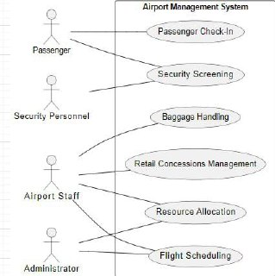
Example for use case Diagram:

Slide 12
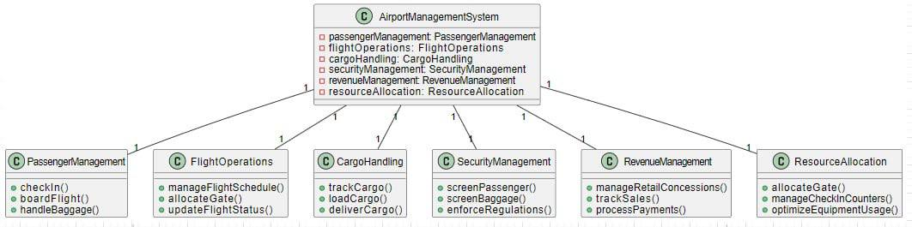
EXAMPLE FOR CLASS DIAGRAM:

Slide 13
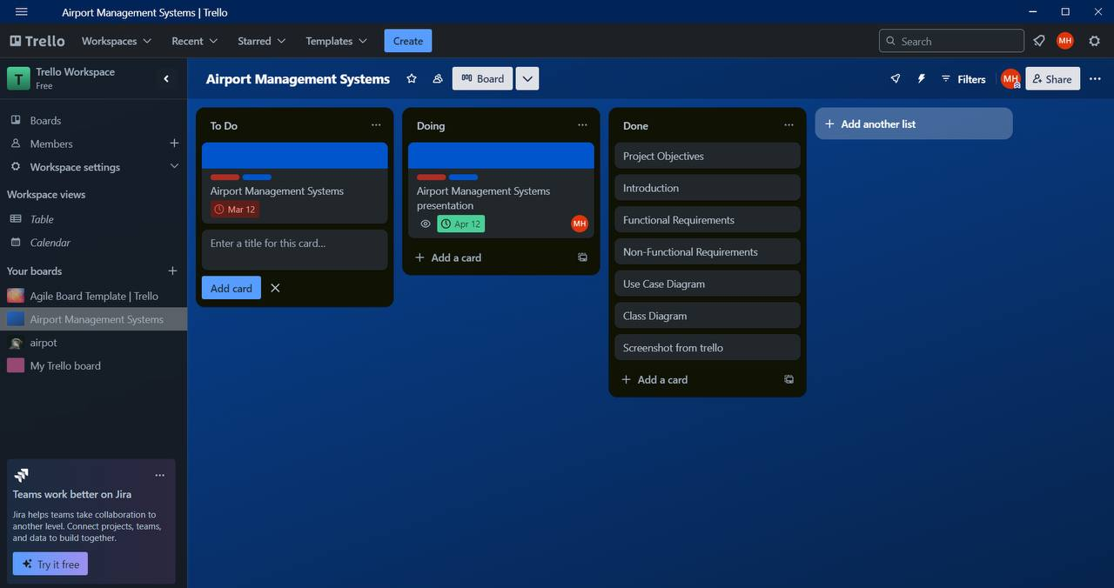

Slide 14


